Slide 1
Mommy Don’t Go
Predicting and preventing recidivism of mothers in the Illinois Criminal Justice System
Team N4: Markus Kessler, Sybille Louis, Him Mistry, and Jessica Raithel
Preliminary Draft - Do Not Cite

Slide 2
Research Question
What are the predictors of mothers in Illinois re-entering the criminal justice system after exit?
Preliminary Draft - Do Not Cite

Slide 3
Background: Female Inmates Have Specific Needs
Women in U.S. prisons has increased by more than 700%, outpacing men by more than 50%
Women offenders primarily commit property and drug offenses vs. more than half of men who commit violent offenses
Women state prisoners exhibit mental health problems more often than men
Women prisoners earn lower monthly incomes than men
Sources: National Resource Center on Justice Involved Women, 2016; Carson, 2015; James & Glaze, 2006; The Sentencing Project, 2007
Preliminary Draft - Do Not Cite
Notes:
Note: Diagnostic and Statistical Manual of Mental Disorders, Fourth Edition (DSM-IV)

Slide 4
Background: Re-Entry and Child Welfare
Two-thirds of women in state prisons are mothers of a minor child
Children of incarcerated parents are at a higher risk of CPS involvement and later criminal involvement, mental and physical health issues
Parental involvement leads to a higher risk of foster care placement
Sources: The Sentencing Project, 2015; Dallaire, Zeman, & Thrash (2015); Miller, Orellana, Johnson, Krase, & Anderson-Nathe (2013); Andersen & Wildeman (2014); Gifford et al. (2016); Muftic & Smith (2015)
Preliminary Draft - Do Not Cite

Slide 5
Background: Neighborhood-level factors
Neighborhood level factors influence physical health, mental health, substance use, and criminal behavior
Access to neighborhood resources, networks and supports impacts reentry outcomes
Sources: Pickett & Pearl, 2001; Ross & Mirowsky, 2001; Mair, Diez-Roux, & Galea, 2008; Sampson et al., 2002; Stahler, Gerald J. et al., 2013; Kubrin & Stewart, 2006; Rose & Clear, 1998; Kirk, 2009
Preliminary Draft - Do Not Cite
Notes:
Neighborhood level factors influence outcomes
An abundance of evidence spanning decades exists concerning the independent influence of neighborhood-level factors on various behavioral and health risk factors and outcomes, including physical health , mental health, and criminal behavior.
Recidivism has traditionally been considered individually determined.

Slide 6
Logic Model
Target Population
Inputs
Activities
Outputs
Short-term
Outcomes
Medium-term
Outcomes
Long- term
Outcomes
Mothers in Illinois
re-entering the criminal justice system
after exit
Expenditures on social services
(direct and in-kind)
Programmatic oversight
Job training
Counseling
Housing services
Substance abuse treatments
Development of new services that address risk factors of recidivism
Improved access to concrete supports for women recently released from prison
Decrease in recidivism
Decreased child welfare involvement
Preliminary Draft - Do Not Cite

Slide 7
Overall Approach
Time-frame: Exiters between 2005 through 2013
Identify population of mothers who have exited jail and their attributes
Identify neighborhood-level characteristics and access to social services
Construct predictors at the individual- and neighborhood-level
Build and train the predictive model
Preliminary Draft - Do Not Cite

Slide 8
Data Sources
Individual-level predictors
Neighborhood-level predictors*
Illinois Department of Correction (admission and exit data)
Length of stay, gang affiliation, substance use, # of previous incarcerations, education level, race, sex, number of children, age, program involvement while in prison, recidivism flag, charge class
Illinois Department of Labor
Employment flag, total wages, # of quarters employed, # of jobs per quarter
Illinois Department of Labor
Number of jobs, firms, and total wages by zip code and industry
American Community Survey (ACS)
Total households, household demographics, poverty level
Social Services
Number of social service and substance abuse facilities in zip code by type
*aggregated and linked to individuals via zip code, as well as distance analysis (zip codes provided in Parole data)
Preliminary Draft - Do Not Cite

Slide 9
Contributions
Descriptive analysis of sample of mothers in prison and characteristics
Spatial analysis using neighborhood characteristics
Combining data on employment, proximity analysis on access to social services and employment deriving distance criteria
Machine Learning: Building a model to predict likelihood of recidivism in population of mothers based on the predictors identified
Preliminary Draft - Do Not Cite

Slide 10
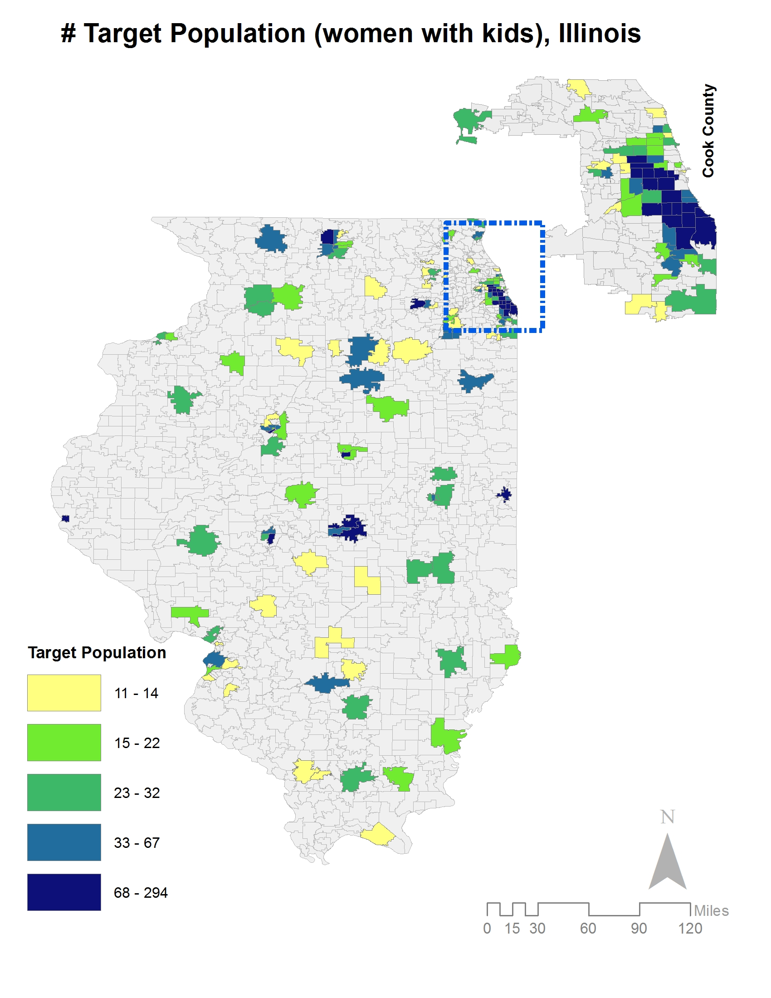
Distribution of Sample = Concentration in Cook County
Preliminary Draft - Do Not Cite

Slide 11
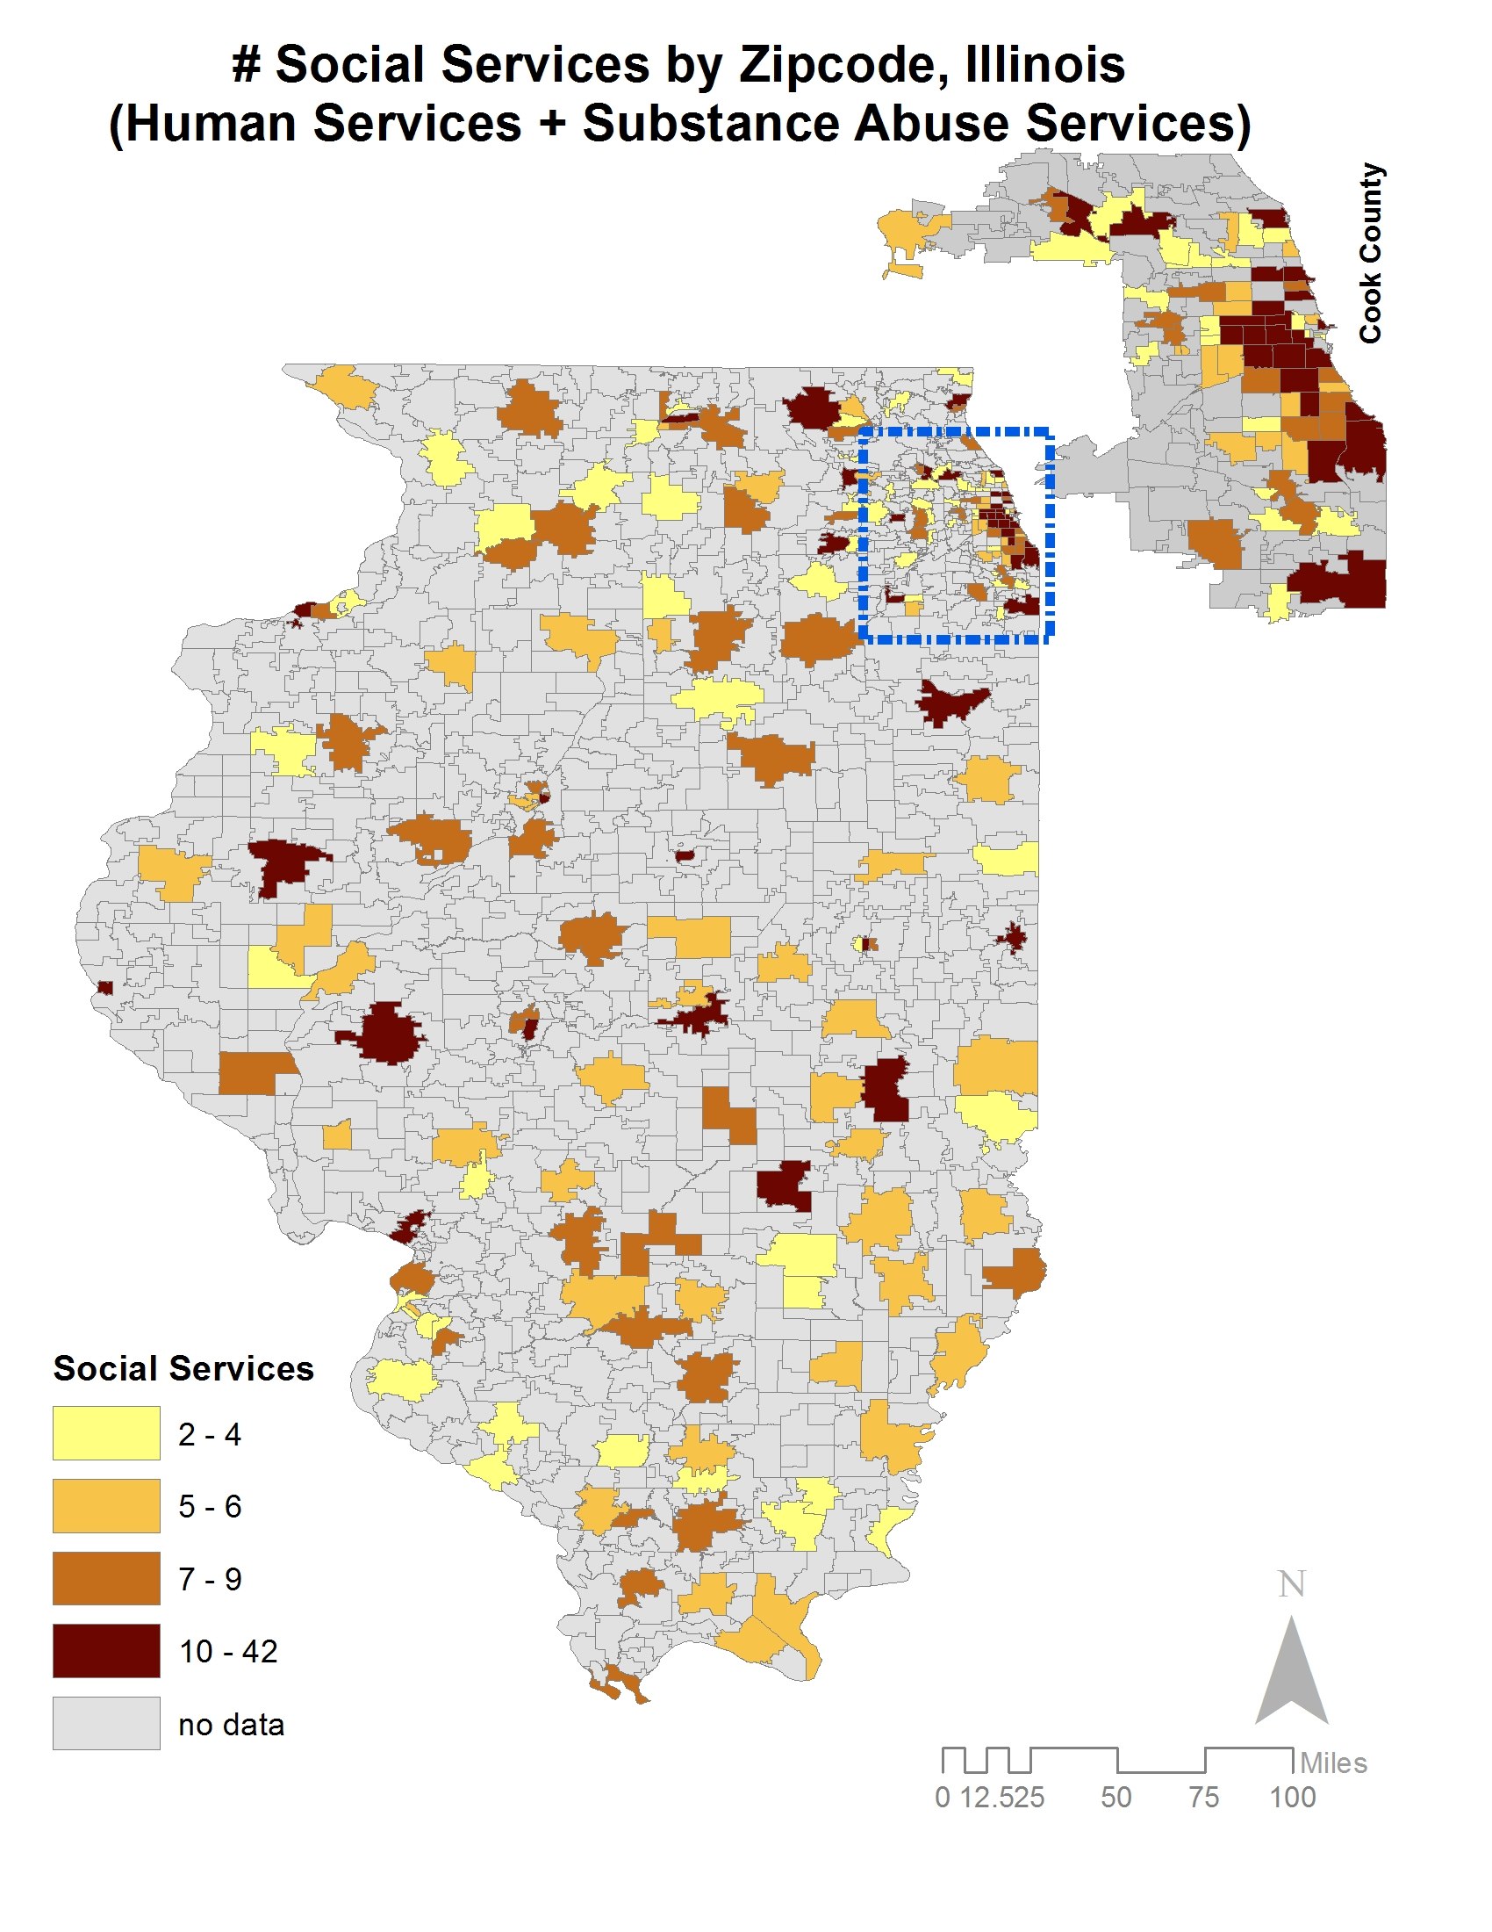
Distribution of Social Services = Concentration in Cook County
Preliminary Draft - Do Not Cite

Slide 12
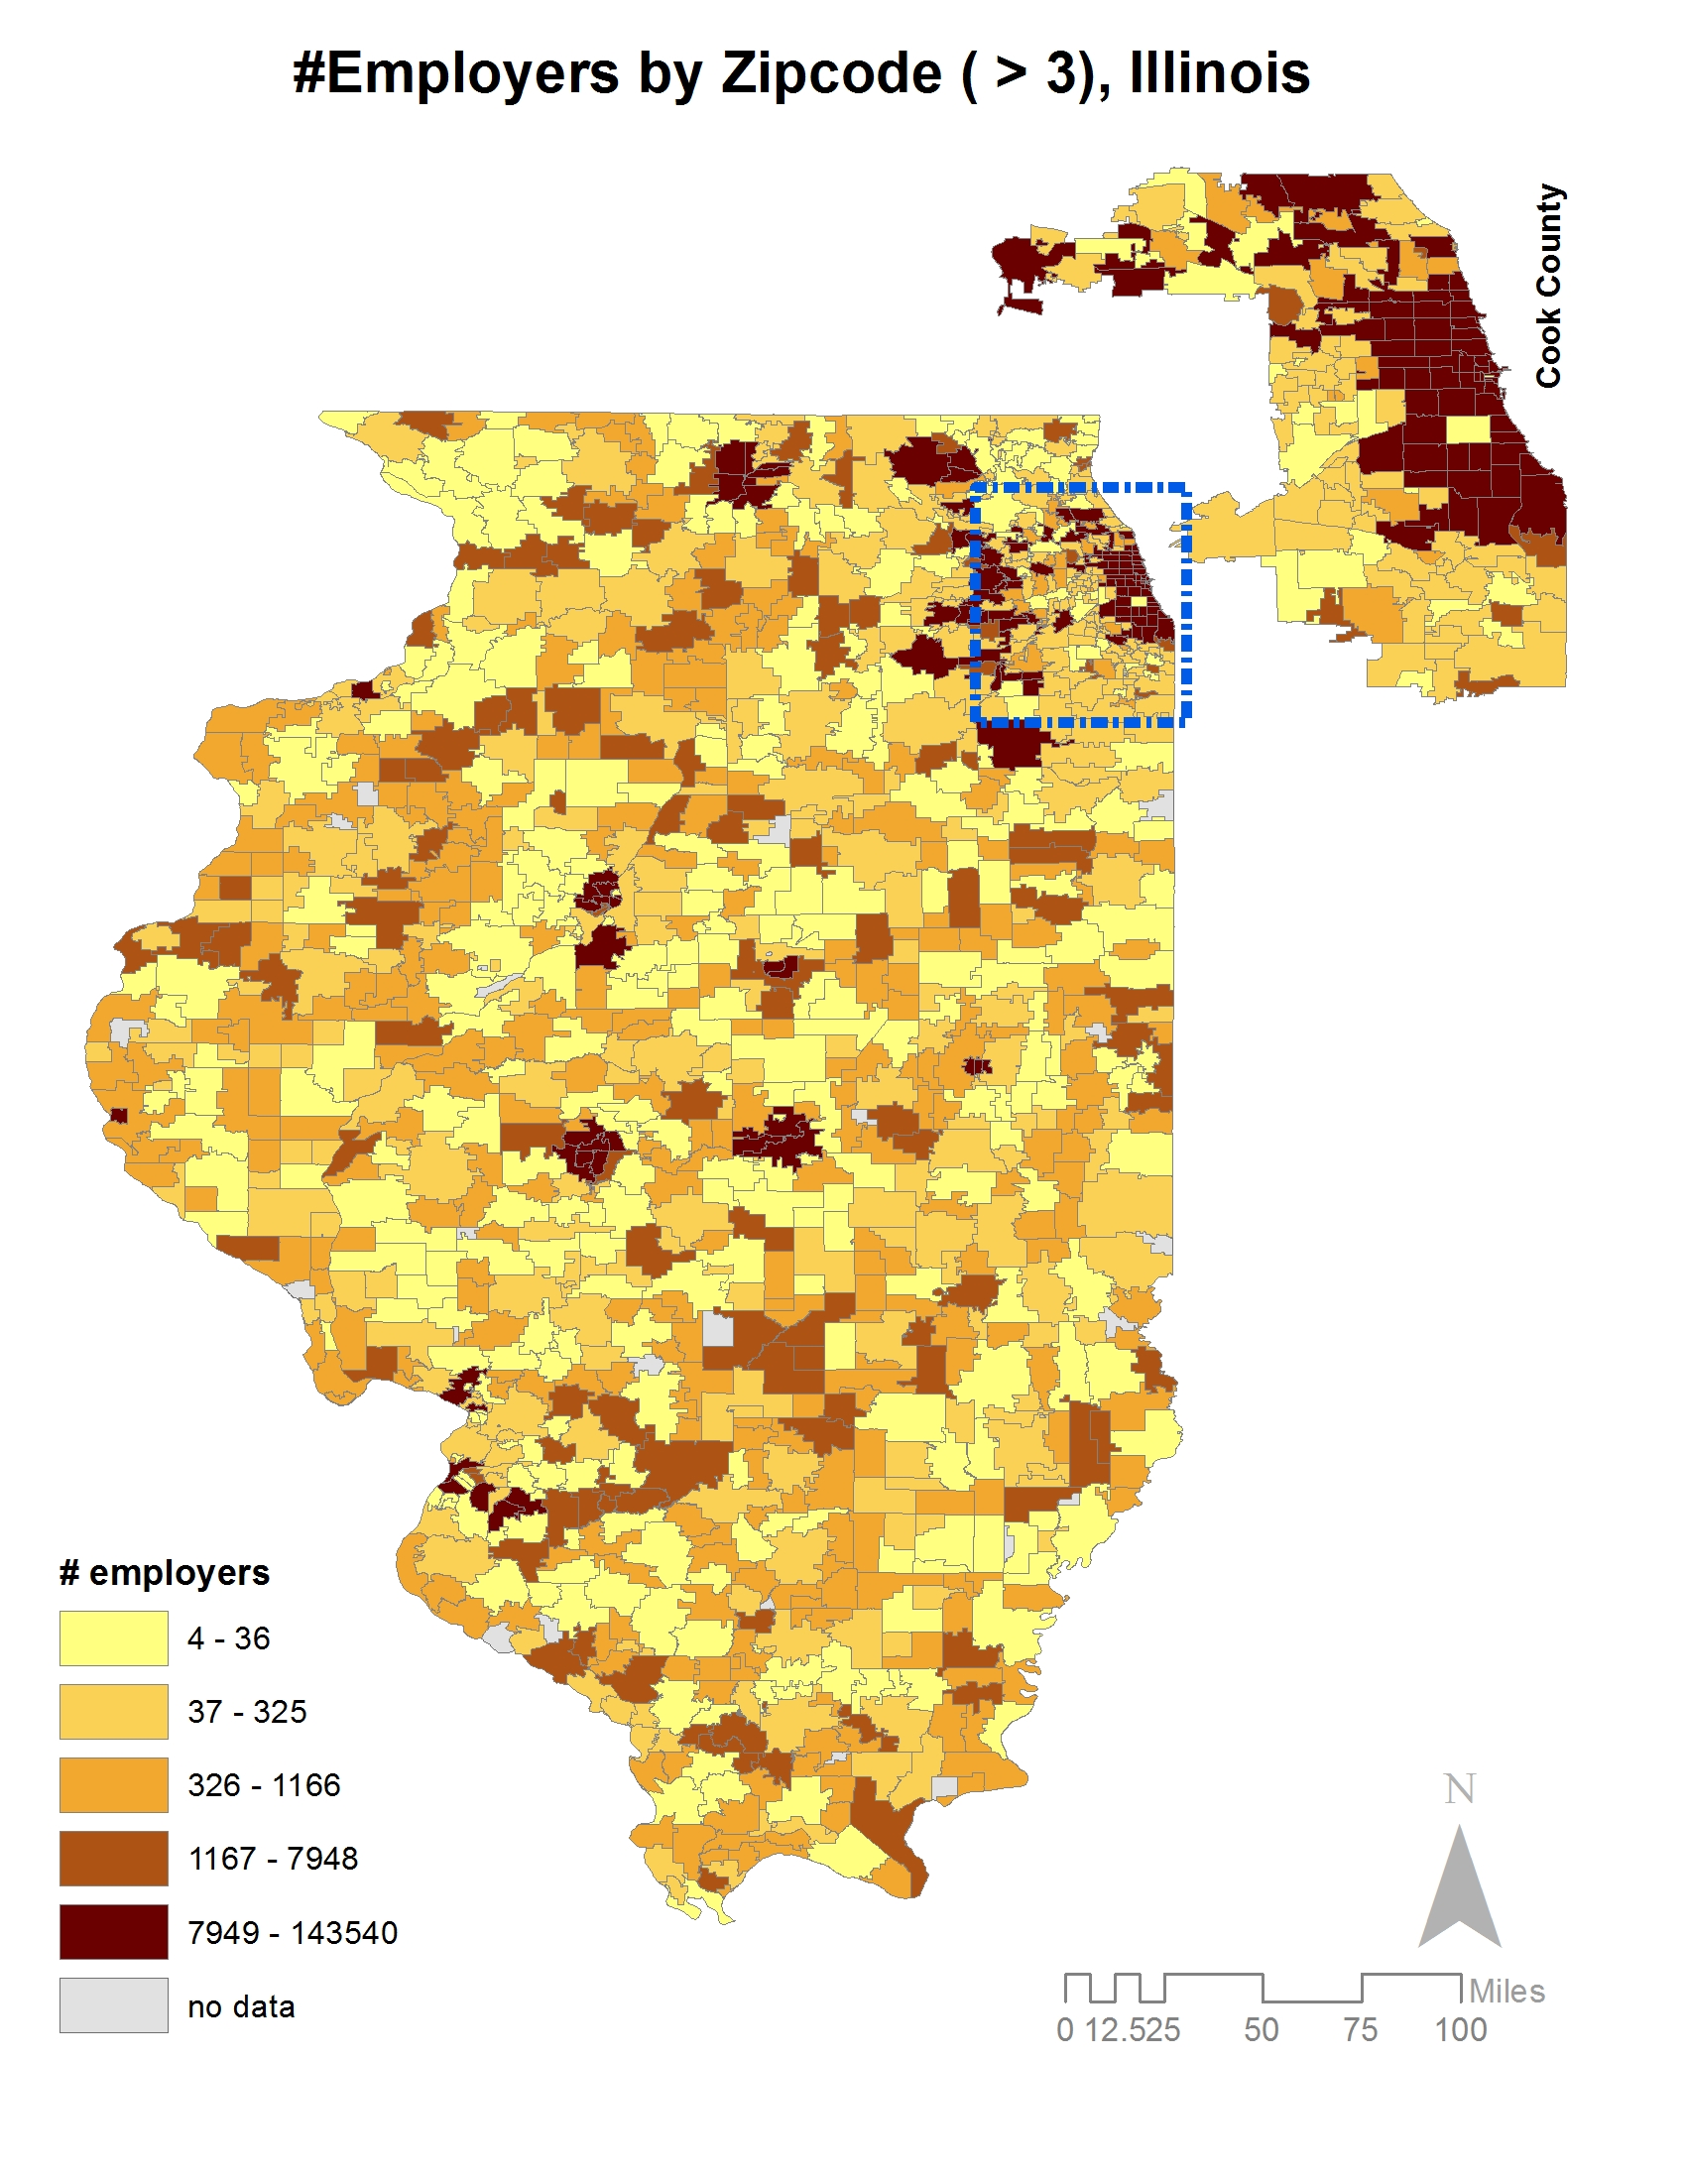
Distribution of Employers = Concentration in Cook County
Preliminary Draft - Do Not Cite

Slide 13
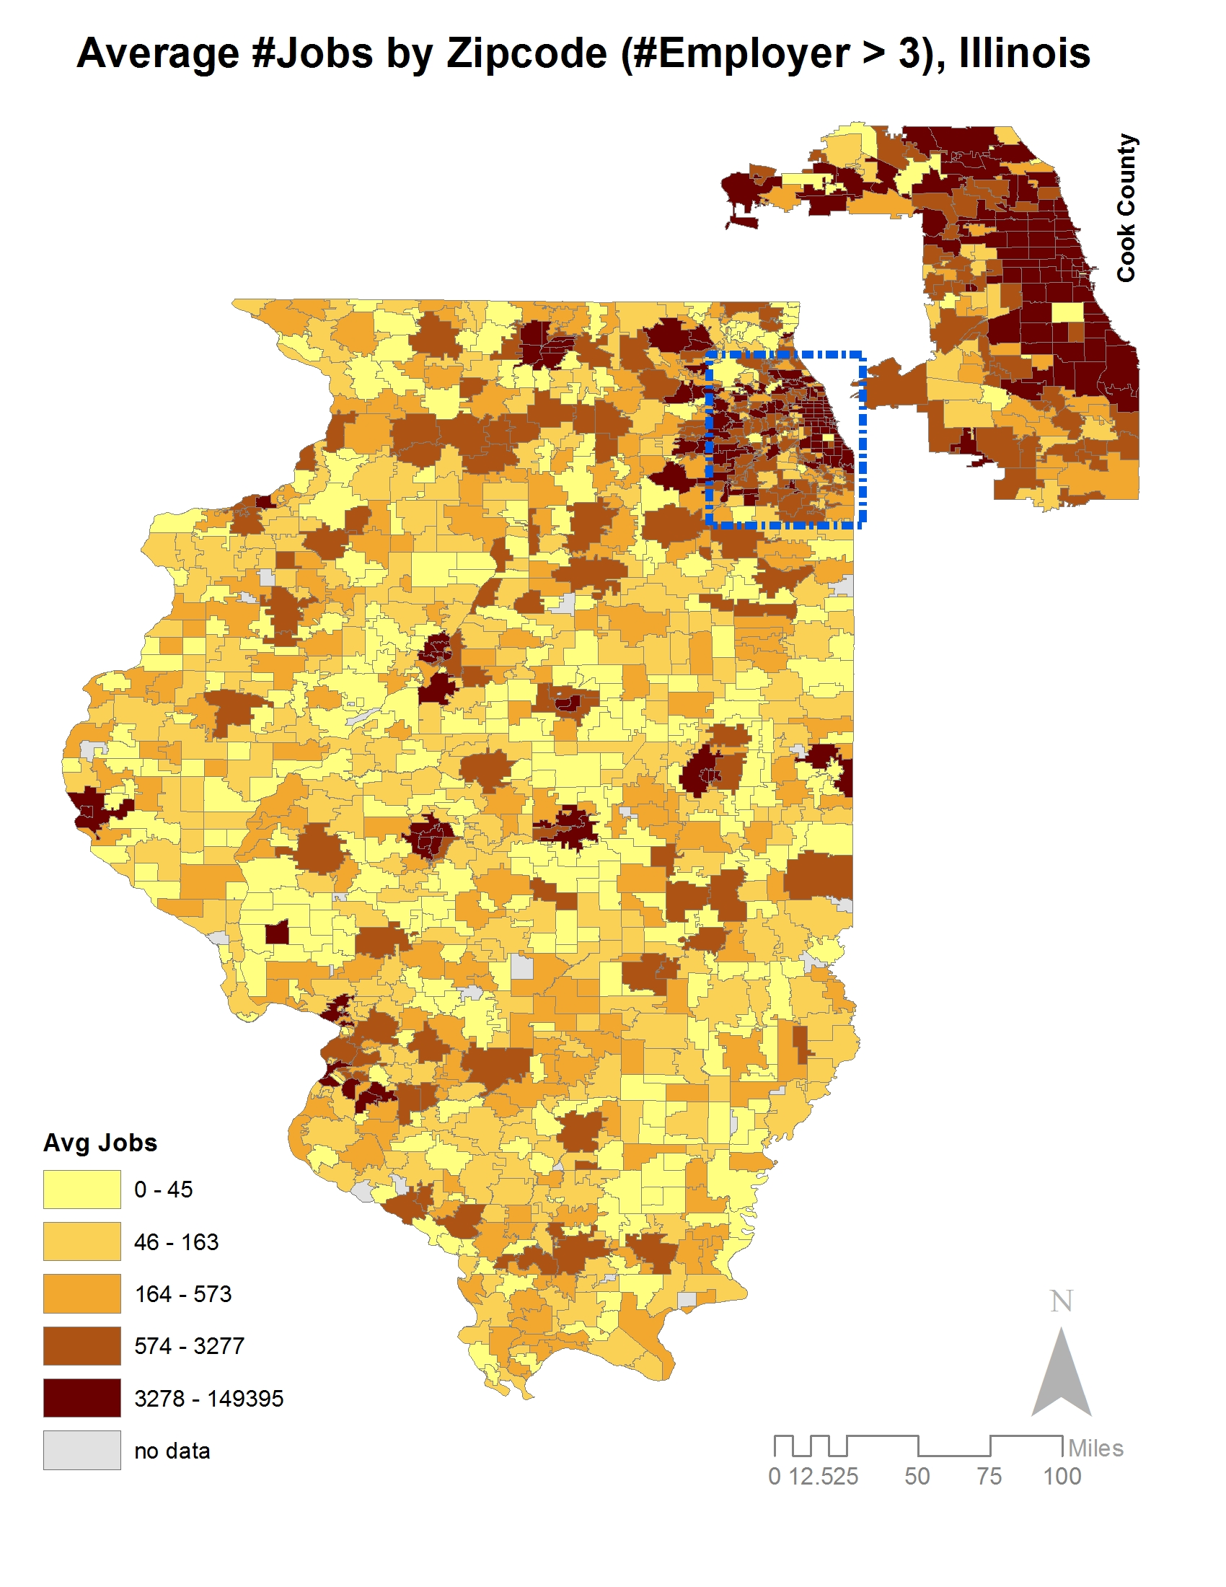
Distribution of Jobs = Concentration in Cook County
Preliminary Draft - Do Not Cite

Slide 14
Description of Sample
Women who exited 2005-2013: 18,491
Women with children who exited 2005-2013: 14,861
Women with children
who exited 2005-2013
with zip code:
8,559*
Sample
*1.6% of the sample was dropped during some analyses due to other missing data
Preliminary Draft - Do Not Cite

Slide 15

Average Age: 37 Race: 52% Black; 42% white; 6% Hispanic
Preliminary Draft - Do Not Cite
Notes:
Who are the women in our sample?
The average age is 43.
About 4,408 (52%) are black; 3,572 (42%) are white; 505 (6%) are Hispanic; Native-Americans at 1% and Asians and others at less than 1%.

Slide 16
More than half (62%) of the women are single
Preliminary Draft - Do Not Cite
Notes:
About 5,336 (62%) are single;
1,387 (16%) are married
1,198 (14%) are divorced
467(5%) separated (the code was X)
and 169 (2%) widowed.

Slide 17
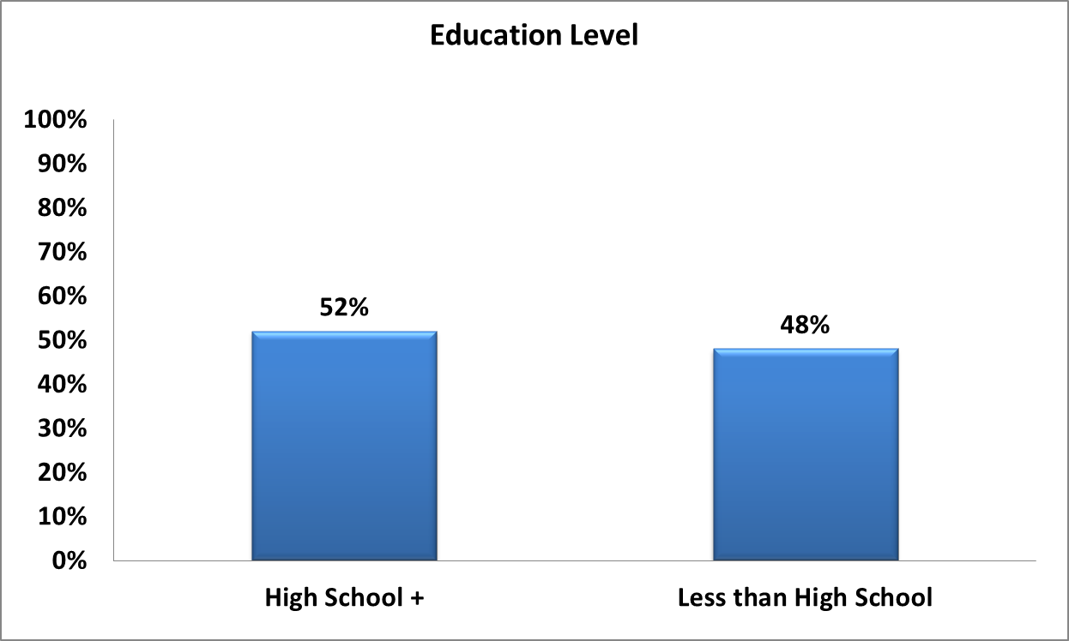
Less than half of the women (48%) have less than a high school diploma
Preliminary Draft - Do Not Cite

Slide 18
42% of women are being held for the longest crime category (Class 4)
Preliminary Draft - Do Not Cite
Notes:
3,567 (42%) were being held for Class 4 crime (forgery/fraud; violation controlled substance)
2,004 (23%) were being held for Class 3 crimes
1,485 (17%) were being held for Class 2 crimes
1,052 (12%) were being held for Class 1 crimes
368 (4%) were being held for Class X crimes
77 (1%) were being held for Murder

Slide 19
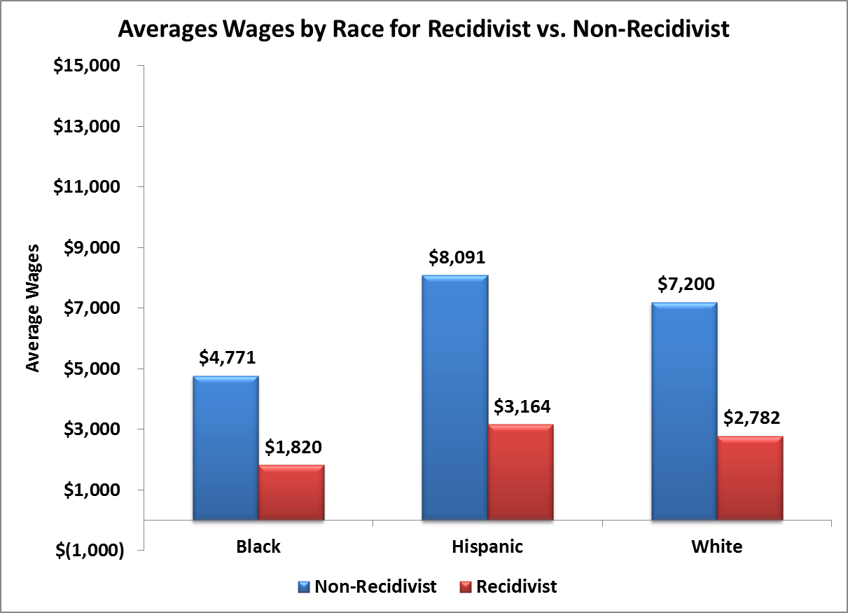
Non-recidivists earn more wages than recidivists across main race categories
Preliminary Draft - Do Not Cite
Notes:
Average Wages by Race and 1 and 2 year recidivism
Whether we look at the heat maps for the one-year and two-year recidivism by race, it appears that those who do not recidivate earn higher wages that those who did.
However, black women tend to earn less than their white and hispanic counterparts.

Slide 20
Machine Learning: Method
Assessed and fit models based on recursive feature elimination (RFE)
Chose the optimal number of features and which features to include
Compared models using the area under the curve (AUC) measure
Once the type of model was chosen, compared models with just individual characteristics and individual + neighborhood level characteristics using RFE and assessing with AUC
Preliminary Draft - Do Not Cite

Slide 21
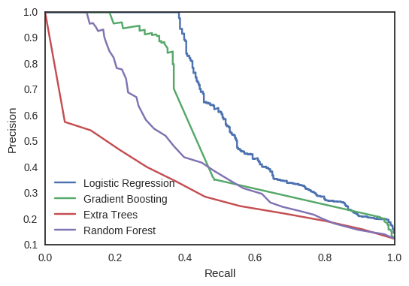
Logistic regression performed best for AUC
Preliminary Draft - Do Not Cite

Slide 22
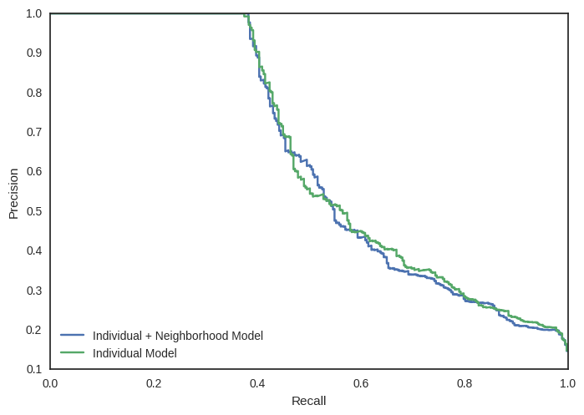
Neighborhood features had more explanatory power than individual features
Preliminary Draft - Do Not Cite

Slide 23
Recall is most informative due to low occurrence of recidivism
 | Individual Only | Individual + Neighborhood
Accuracy | 0.92 | 0.92
Recall | 0.38 | 0.39
Precision | 0.99 | 0.94
Preliminary Draft - Do Not Cite

Slide 24
Top Features from Individual + Neighborhood Model
Employment-related Features
Average Wages per Quarter in the Community (2 yr) (+)
Average Wages per Quarter in the Community (1yr) (+)
Total Wages (1 yr) (-)
Total Wages (2 yrs) (-)
Average Number of Jobs per Qtr in Community (2 yr) (-)
Percent of Qtrs in the Community Spent Employed (2 yr) (-)
Neighborhood Features
Number of Employers Missing Industry in Zip Code (+)
Number of Wholesale Trade Employers in Zip Code (-)
Number of Real Estate Employers in Zip Code (-)
Number of Detox Centers in Zip Code (+)
Number of Administrative/Support/Waste Management/ Remediation Services Employers in Zip Code (-)
Number of Accommodations/Food Employers in Zip Code (-)
Number of Arts, Recreation, and Entertainment Employers in Zip Code (+)
Number of Public Administration Employers in Zip Code
Number of Finance Employers in Zip Code (+)
Number of Other Employers in Zip Code (+)
Number of Education Employers in Zip Code (+)
Number of Transportation and Warehouse Employers in Zip Code (+)
Percent of Population who is White in Zip Code (-)
DOC-related Features
Age at Exit (-)
Race: White (+)
Exit Quarter (-)
Citizen (-)
High School Education or Higher (-)
Number of Kids (-)
Number of Incarcerations (+)
Number of Incarcerations in Illinois (+)
Length of Current Incarceration (-)
Holding Charge Class 4 (+)
Holding Charge Class 2 (-)
Holding Charge Class 1 (-)
Drug Use: Heroin (+)
Sex Offender Status (+)
Admission Directly from Court (-)
Exit Type: Released to Supervision (-)
Preliminary Draft - Do Not Cite

Slide 25
Top Features from Individual + Neighborhood Model
Employment-related Features
Average Wages per Quarter in the Community (2 yr) (+)
Average Wages per Quarter in the Community (1yr) (+)
Total Wages (1 yr) (-)
Total Wages (2 yrs) (-)
Average Number of Jobs per Qtr in Community (2 yr) (-)
Percent of Qtrs in the Community Spent Employed (2 yr) (-)
Neighborhood Features
Number of Employers Missing Industry in Zip Code (+)
Number of Wholesale Trade Employers in Zip Code (-)
Number of Real Estate Employers in Zip Code (-)
Number of Detox Centers in Zip Code (+)
Number of Administrative/Support/Waste Management/ Remediation Services Employers in Zip Code (-)
Number of Accommodations/Food Employers in Zip Code (-)
Number of Arts, Recreation, and Entertainment Employers in Zip Code (+)
Number of Public Administration Employers in Zip Code
Number of Finance Employers in Zip Code (+)
Number of Other Employers in Zip Code (+)
Number of Education Employers in Zip Code (+)
Number of Transportation and Warehouse Employers in Zip Code (+)
Percent of Population who is White in Zip Code (-)
DOC-related Features
Age at Exit (-)
Race: White (+)
Exit Quarter (-)
Citizen (-)
High School Education or Higher (-)
Number of Kids (-)
Number of Incarcerations (+)
Number of Incarcerations in Illinois (+)
Length of Current Incarceration (-)
Holding Charge Class 4 (+)
Holding Charge Class 2 (-)
Holding Charge Class 1 (-)
Drug Use: Heroin (+)
Sex Offender Status (+)
Admission Directly from Court (-)
Exit Type: Released to Supervision (-)
Preliminary Draft - Do Not Cite

Slide 26
Caveats
DOC/Parole data
Missing data, especially zip codes
Accuracy of addresses
Some relevant data not collected (e.g. age of the kids)
Data generating process -- self-reporting of most data
Employer data
Over-reporting due to employer name changes and chances of being counted multiple times
Discrepancy in location reported (location of headquarters versus actual employment location)
Quarterly reported wages, but not hours/weeks
Inferential goal
Underlying inference is aimed at improving child and family well-being outcomes
Preliminary Draft - Do Not Cite

Slide 27
Next Steps
Include additional community-level factors or other public data sources (including outside the ADRF) that could be helpful predictors
Additional geospatial analyses to control for density of services and people in Chicago versus the rest of the state
Research on best practice interventions and supports for addressing identified risk factors of our target population
Service gap analysis in communities with high level of risk factors
Translate/replicate for New York City or other localities to contextualize findings and interventions
Preliminary Draft - Do Not Cite

